Slide 1
LENDING CLUB CASE STUDY
BY:
SATYA SHANMUKH
MLC_49
satya6face@gmail.com

Slide 2
CASE STUDY
Business Objective
Lending club is the largest online loan marketplace where Borrowers
can easily access loans. The company wants to understand the driving factors behind loan
default, i.e. the variables which are strong indicators of default. The company
can utilize this knowledge for its portfolio and risk assessment.
Problem Statement
▪ Borrowers who default cause the largest amount of loss to the
lenders. In this case, the customers labelled as 'charged-off' are the
'defaulters’.
▪ So, identify these risky loan applicants, then such loans can be
Reduced thereby cutting down the amount of credit loss.

Slide 3
PROCESS FLOW
RAW DATA
DATA CLEANING
DATA ANALYSIS
RECOMMENDATIONS AND COMMENTS

Slide 4
Data Analysis Approach
Data Cleaning ▪ Drop Column With Null Values ▪ Drop Unnecessary Columns Which Not Needed For Our Analysis ▪ Done Data Manipulation
Data preparation ▪ Convert To Proper Data Types
Univariate Analysis ▪ Check distribution of numerical variables
Bivariate Analysis ▪ Analyse variable against another variable ▪ Find correlation analysis

Slide 5
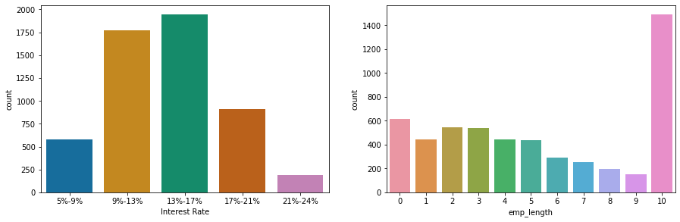

Slide 6
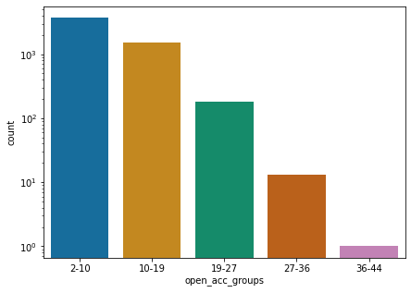
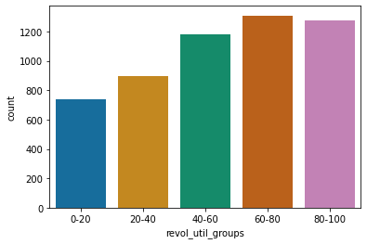
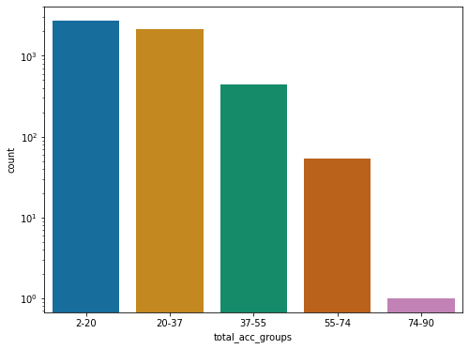
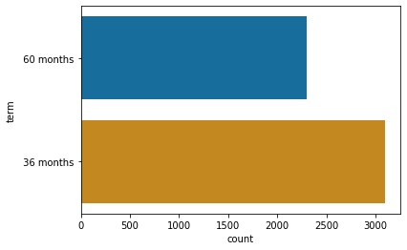

Slide 7
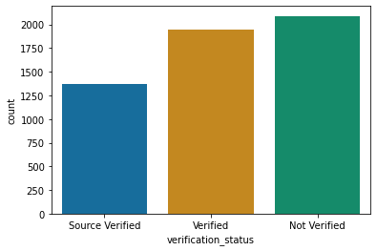
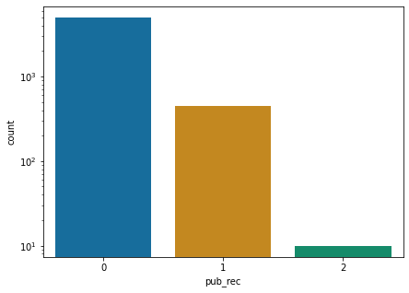
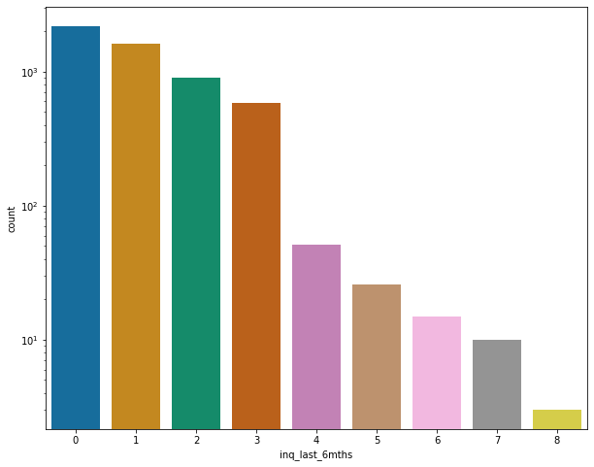

Slide 8
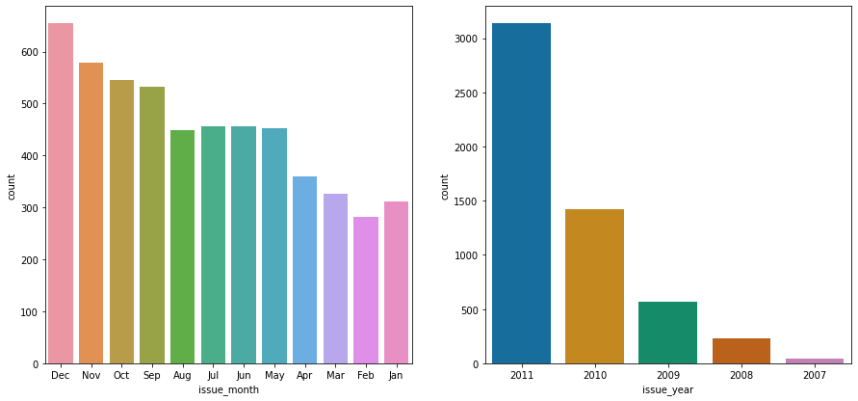

Slide 9
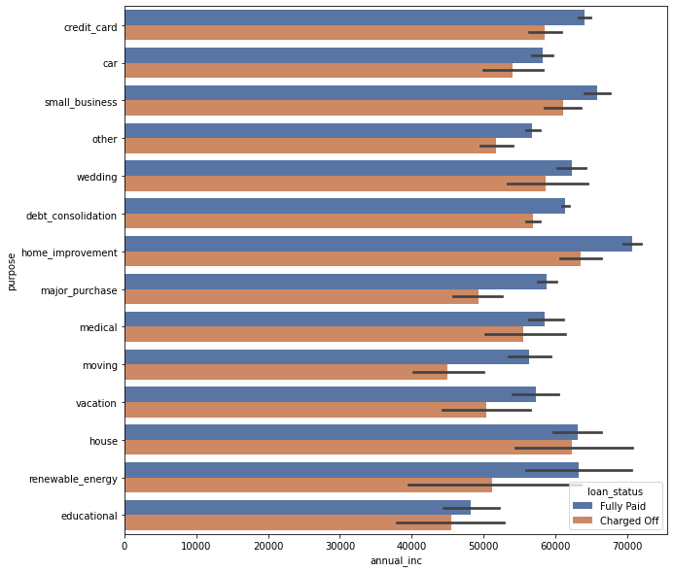

Slide 10
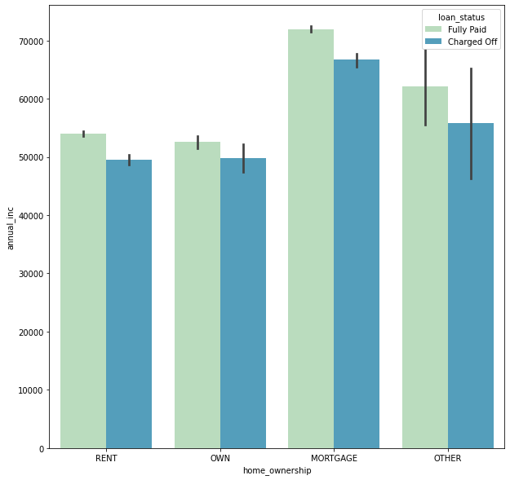

Slide 11
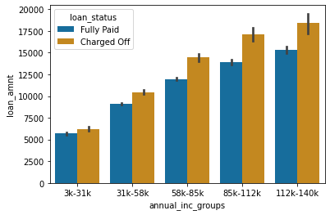
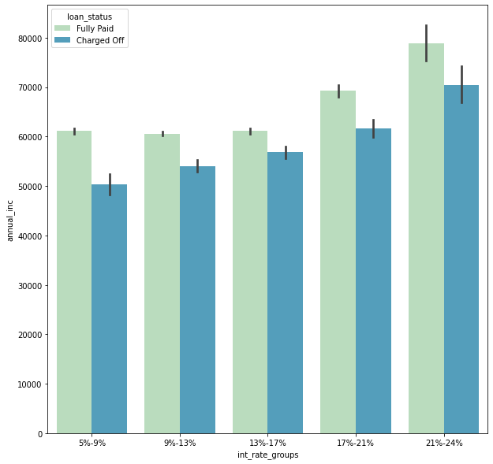

Slide 12
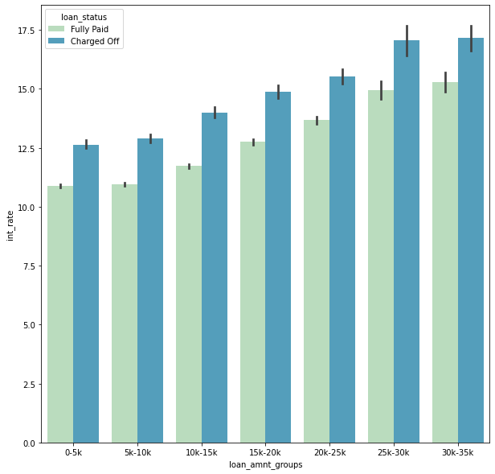

Slide 13
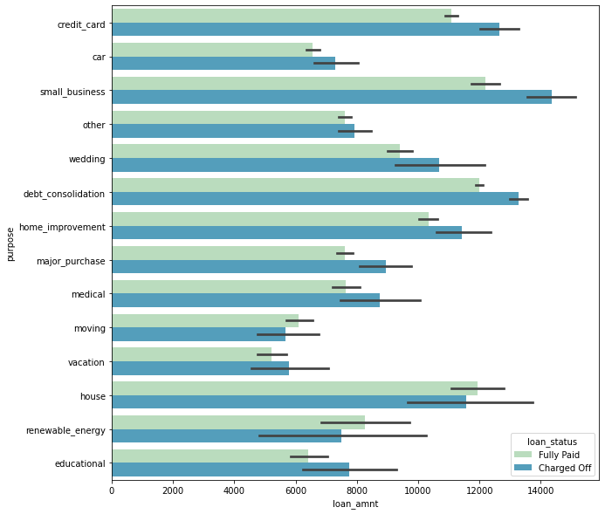

Slide 14
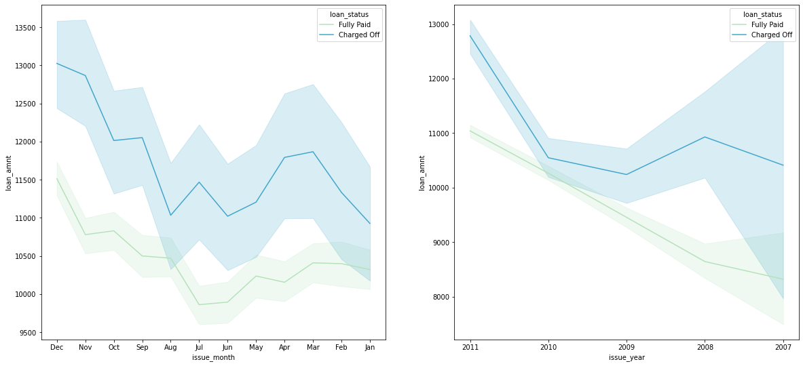

Slide 15
Observations
The Above Analysis With Respect To The Charged Off Loans.There Is A More Probability Of Defaulting When :
Applicants Taking Loan For 'Home Improvement' And Have Income Of 60k -70k
Applicants Whose Home Ownership Is 'MORTGAGE And Have Income Of 60-70k
Applicants Who Have Taken A Loan In The Range 30k - 35k And Are Charged Interest Rate Of 15-17.5 %
Applicants Who Have Taken A Loan For Small Business And The Loan Amount Is Greater Than 14k
Applicants Who Receive Interest At The Rate Of 21-24% And Have An Income Of 70k-80k
When Grade Is F And Loan Amount Is Between 15k-20k
For Grade G And Interest Rate Above 20%
Applicants Whose Home Ownership Is 'MORTGAGE And Have Loan Of 14-16k
When The Loan Is Verified And Loan Amount Is Above 16k
When Employment Length Is 10yrs And Loan Amount Is 12k-14k

Slide 16
Recommendations
According To The Above Analysis.
The Loan Should Be Sanctioned On The Basics Of Above Observations And Guidelines Inorder To Reduce The Defaulters And Lose To The Organization

